Slide 1
Class of 2018 Class of 2019 Class of 2020 COURSE REGISTRATION 2017 - 2018
Padua
Franciscan
1Team
1Dream
1Family

Slide 2
Today you received a Registration Worksheet from your guidance counselor
2017-2018

Slide 3
You must complete this worksheet with your parents ASAP.
2017-2018

Slide 4
Your worksheet looks like this
2017-2018
Student Name is preprinted
Back side of worksheet
Front side of worksheet

Slide 5
You must complete both sides of the worksheet for course registration. This worksheet will be collected at registration.
2017-2018

Slide 6
2017-2018
Before Registration:
Talk to your teachers about your recommended courses and write course numbers on worksheet

Slide 7
2017-2018
Before Registration:
Talk with parents about courses for next year and review graduation requirements.

Slide 8
Review the Registration Process PaduaFranciscan.com.Academics> 2017-2018 Course Registration
2017-2018
2017-2018
Download Course Selection Guide 2017-2018 .pdf
In School Chromebook Registration Dates
Class of 2018 February 8, 2017
Class of 2019 February 15, 2017
Class of 2020 February 23, 2017

Slide 9
2017-2018
Review Padua Graduation Requirements at Paduafranciscan.com> Academics>Course Catalog
2017-2018 Course Registration
Download 2017-2018 Course Catalog .pdf
Use Course Catalog to review Padua Graduation Requirements and to find course information including course numbers
Course Catalog

Slide 10
2017-2018
Before Registration:
Complete worksheet front and back.
Be sure to include the course numbers.

Slide 11
2017-2018
Indicate MedTrack, 4 Yr. Art or Computer Student if it applies.
Enter or circle course numbers in rows 1 through 8b.
Lines SS through AS are optional classes offered outside of the regular school day. Only circle if you plan to take these courses.

Slide 12
2017-2018
Indicate MedTrack, 4 Yr. Art or Computer Student if it applies.
Enter or circle course numbers in rows 1 through 8b.
Lines SS through AS are optional classes offered outside of the regular school day. Only circle if you plan to take these courses.

Slide 13
2017-2018
Select Padua summer school courses if you plan to take summer PE or Medical Terminology; otherwise leave these fields blank.

Slide 14
2017-2018
Select Before school courses or leave blank. Please note Greek will be offered after school not before school.

Slide 15
2017-2018
Select After school courses or leave blank. Choices are Marching Band, Yearbook, Horizon, and Greek (which is listed in the Before School cells).

Slide 16
2017-2018
You should select 587 Adv. Computer Applications as one of your electives if you haven’t taken it yet.

Slide 17
2017-2018
Electives Preferences
Found on back of Worksheet
Number your top ten preferences for electives. An * denotes semester courses and (9,10,11,12) lists which grade levels

Slide 18
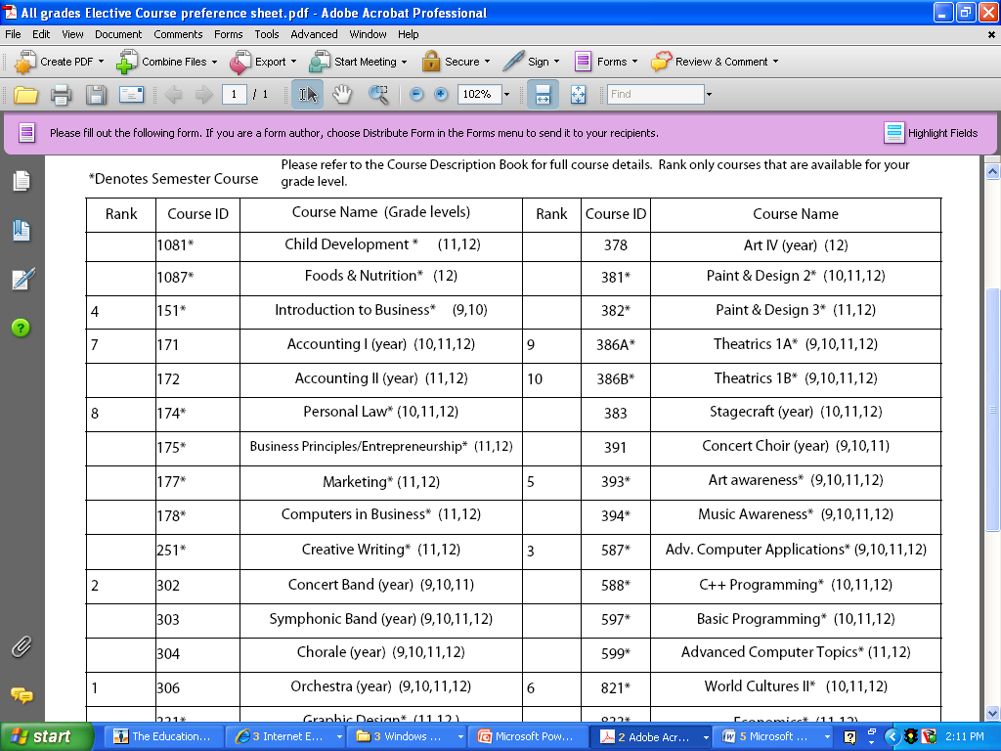
2017-2018
Rank your top ten electives
1-10. Only rank courses that are available for your grade level. Numbering only one class will not guarantee your schedule for it. Placement depends upon course availability.

Slide 19
2017-2018
Rank your top ten elective choices
Padua’s Graduation Requirements are listed at the bottom of the Electives sheet.

Slide 20
2017-2018
Registration Dates:
Class of 2018
Wednesday,
February 8th
during homeroom

Slide 21
2017-2018
Registration Dates:
Class of 2019
Wednesday,
February 15th
during homeroom

Slide 22
2017-2018
Registration Dates:
Class of 2020
Thursday,
February 23
during homeroom

Slide 23
2017-2018
Day of Registration
Bring your completed
(both sides) worksheet
to Registration.

Slide 24
2017-2018
Day of Registration
Bring your Chromebook to registration. Turn it on and log in to your homepage.

Slide 25
2017-2018
Day of Registration
Access NetClassroom as soon as you get to Homeroom

Slide 26
Log in to NetClassroom through the Student/Parent Login.
2017-2018
Issues with login?
Login information is available,
see Mrs. Frech in the library.

Slide 27
2017-2018
Course catalog gives brief description of courses
Go to Registration/Enter Requests
Click on Edit Requests

Slide 28
2017-2018
Do not use browser back, forward or refresh arrows.

Slide 29
2017-2018
Front Side
Back Side
Use the course registration and elective forms you completed earlier as references.

Slide 30
2017-2018
Select course from each drop-down menu. Some courses have been preselected in the grid below. Use the course registration worksheet as your guide.

Slide 31
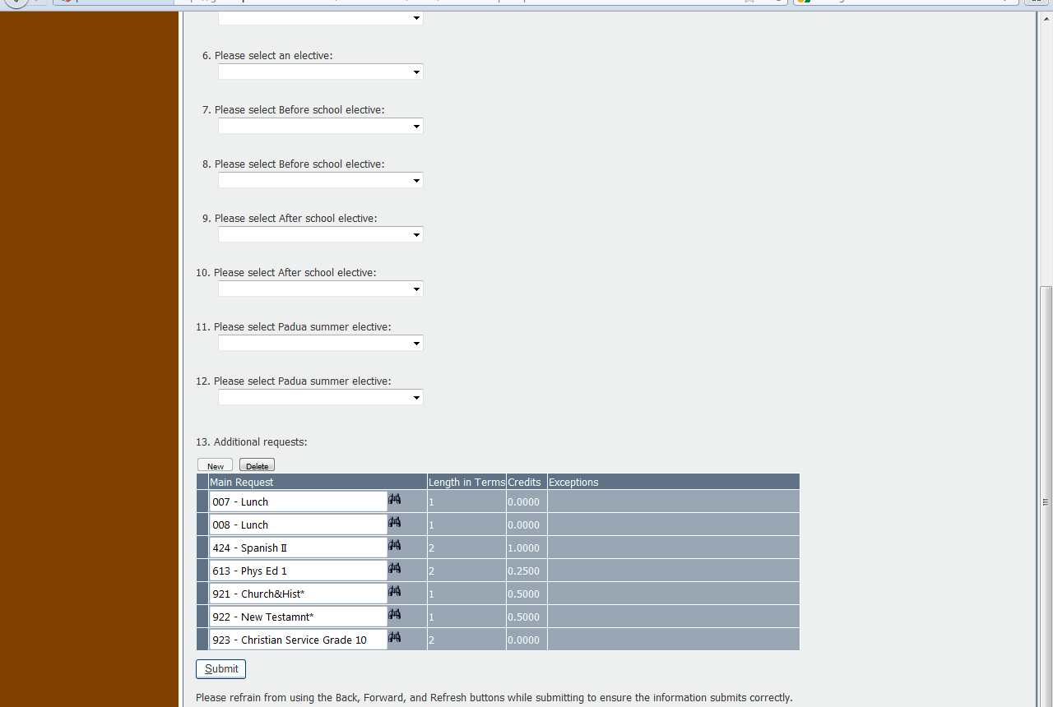
2017-2018
Click on this little cell to select the course you want to delete.
Click “Delete” after selecting the course.
You can delete a course from the grid if you make a mistake or change your mind.

Slide 32
2017-2018

Slide 33
2017-2018
Important: Review courses selected in each line and in the grid below before submitting.
You must click “Submit” to complete the process. (Click Once)

Slide 34
2017-2018
You must complete the process in one log in.

Slide 35
2017-2018
You must complete this registration by the end of Homeroom.

Slide 36
2017-2018
Homeroom Teachers can help you with course recommendations and numbers

Slide 37
2017-2018
Homeroom teachers will collect your worksheet when you are finished with your form.

Slide 38
2017-2018
See Mrs. Holzheimer in Guidance ASAP if you don’t complete your registration.

Slide 39
2017-2018
Make an appointment to see your counselor if you have any questions or have problems with registration.
Grade 9 Mrs. Sidoti
Grade 10 Mrs. Smyth
Jr/Sr MedTrack Mr. Daniel
A-H & Fr/So M/T Mr. Shuman
I-N Mrs. Holz
O-Z Ms. Bertin

Slide 40
2017-2018
A Parent Course Registration Review packet will be mailed to your home soon after you register.

Slide 41
2017-2018
Your parent
must review
the form
and
sign it.

Slide 42
2017-2018
Form must be returned to Guidance by form deadline to reserve a schedule for you.

Slide 43
2017-2018
Parents should contact your counselor if they have questions or concerns

Slide 44
IMPORTANT DATES
Class of 2018
Parent Review Form Due Feb. 17
Mail or deliver to Guidance

Slide 45
IMPORTANT DATES
Class of 2019
Parent Review Form Due Feb. 24
Mail or deliver to Guidance

Slide 46
IMPORTANT DATES
Class of 2020
Parent Review Form Due March 6
Mail or deliver to Guidance

Slide 47
2017-2018
Paduafranciscan.com
>Academics
>2017-2018 Course Registration
for dates and further information

