Slide 1
Padua Franciscan High School Guidance Department
Sophomore Career & College Planning Night

Slide 2
Overview of Year
JUNIORS
THEME – What am I doing, where am I going and how do I get there?

Slide 3


Slide 4
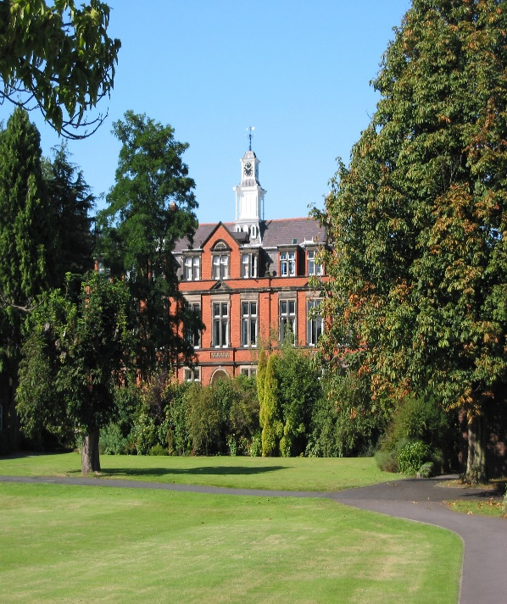

Overview of Year
SOPHOMORES
THEME – Career choices
point to college majors

Slide 5

Outline on the evening
1) College Admissions Overview
  GPA & Rankings
  Admissions Test Scores
  Holistic vs. “Numbers Game”
  College/Career Enrichment
2) College/Career Exploration
  Family Connection Tutorial
3) Financial Planning for College

Slide 6


Slide 7


What are Colleges looking for?
Scores and rankings (admitted 2015)
●GPA Information not published
Ranked in top 10% of H.S. class: 65%
Ranked in top 25% of H.S. class: 96%
ACT composite score range for the middle 50% = 27–32
SAT score range (critical reading and math only) for the middle 50% = 1220–1370
Scores and rankings (admitted 2015)
●Avg. GPA (4.0 scale) = 3.21
●GPA of 3.75 and above = 22%
●Ranked in top 10% of H.S. class: 16%
● Ranked in top 25% of H.S. class: 38%
●ACT composite score range for the middle 50% = 19–26
●SAT score range (critical reading & math only) for middle 50% = 900–1200

Slide 8

College/Career Enrichment
Other Admission Factors
Volunteer Opportunities
Summer Enrichment Programs
Importance of the Resume

Slide 9

COLLEGE ADMISSIONS TESTS
COLLEGE ADMISSIONS
TESTS

Slide 10

ACT vs. SAT
SAT
ACT
Strong emphasis on vocabulary & Critical Thinking / Reasoning skills
5 Reading Passages
Optional Essay focus: comprehension
Scoring Scale = 400-1600
Straight-Forward Questions
Science Section
4 Reading Passages
Optional Essay focus: evaluate & take a position
Scoring Scale = 1-36

Slide 11

Test Prep Handout –inside tonight’s folder
PSAT & Khan Academy

Slide 12
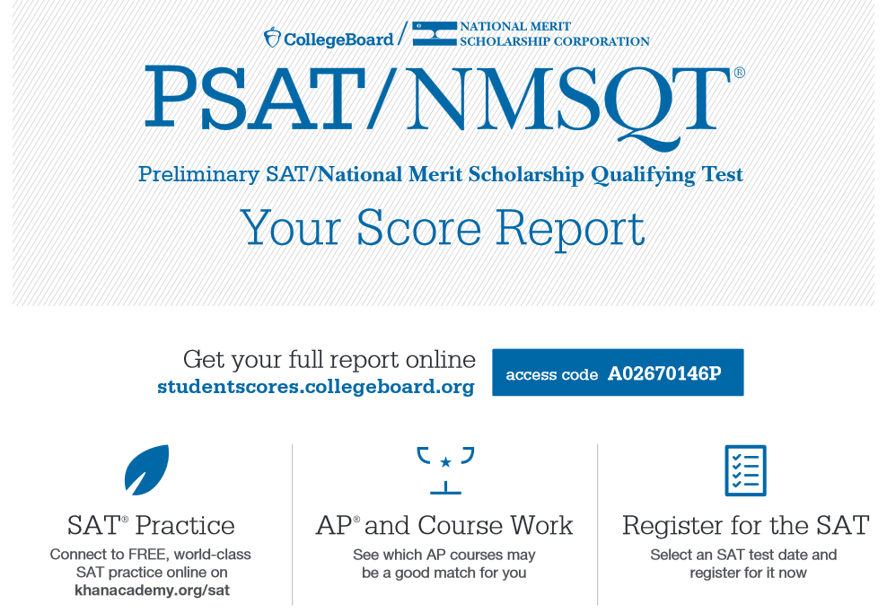

PSAT & Khan Academy

Slide 13


Slide 14


Slide 15
Top Ten College Majors
1. Business Admin & Management
2. Psychology
3. Nursing
4. Biology
5. Teacher Education
6. Criminal Justice
7. Accounting
8. Liberal Arts & Sciences/Humanities
9. English
10. History

Slide 16
Top 10 Careers with Most Openings (Projected 2012-2022 with 4-yr college degree)
1. General and Operations Managers
2. Accountants and Auditors
3. Elementary School Teachers
4. High School Teachers
5. Management Analysts
6. Software Developers
7. Middle School Teachers
8. Computer Systems Analysts
9. Market Research Analysts and Specialists
10. Construction Managers

Slide 17


Slide 18
TOP 5 WORST (BUT SURPRISINGLY COMMON) REASONS FOR CHOOSING A CAREER
1. I HEARD THEY MAKE A LOT OF MONEY
2. MY PARENTS TOLD ME TO
3. IT SOUNDED EASY
4. ALL MY FRIENDS WERE _______ MAJORS
5. JOB SECURITY

Slide 19


Slide 20

FAMILY CONNECTION

Slide 21
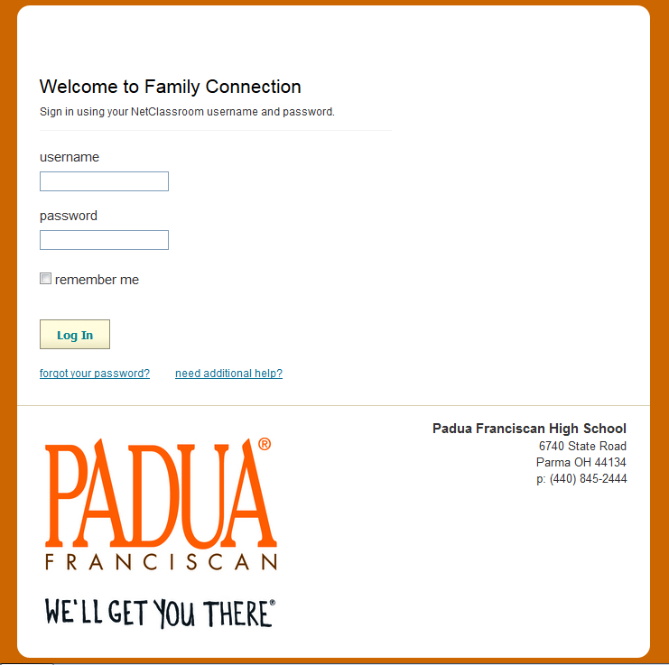
FAMILY CONNECTION

Slide 22
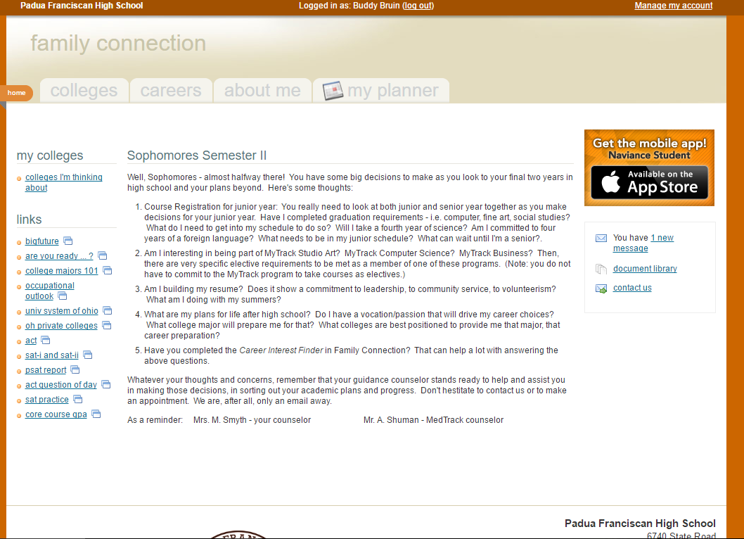

Slide 23
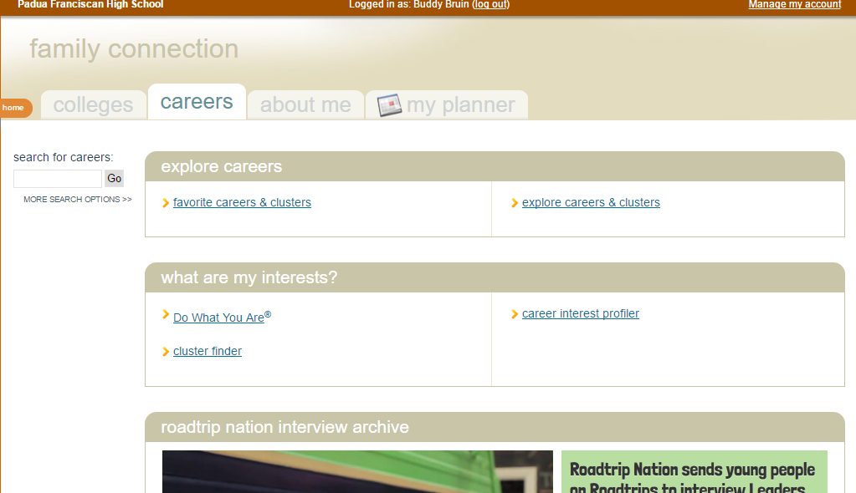

Slide 24


Financial Planning

Slide 25
REMINDERS
Timeline handout located in tonight’s folder
Additional Handouts: Religious Vocations, College Athletics, and Military Options
Career & College Planning Events:
  - February 23nd: Career Speaker selection
  - April 12th : Career Speaker Forum
  - May: Presentation by Baldwin Wallace University on
  college selection via college major focus

Slide 26


Slide 27


