Slide 1
Padua Franciscan High School Guidance Department
Sophomore Career & College Planning Night

Slide 3
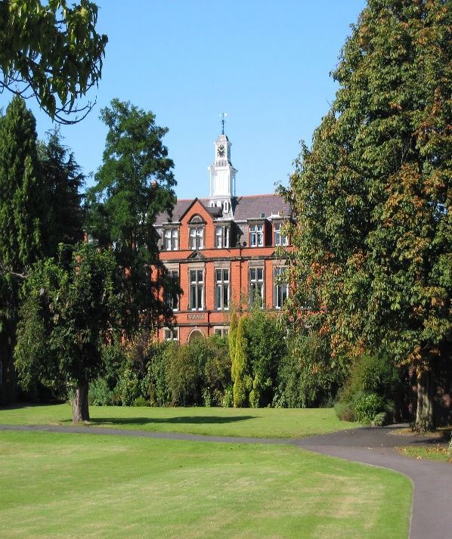
Overview of Year SOPHOMORES
THEME – Career choices
point to college majors

Slide 4
Outline on the evening
1) College Admissions Overview
GPA & Rankings (transcripts)
Review Test Scores
Holistic vs. “Numbers Game”
College/Career Enrichment
2) College/Career Exploration
Family Connection Tutorial
3) Financial Aid – Pam Sandoval

Slide 6
What are Colleges looking for?
Scores and rankings (admitted 2017)
●GPA Information not published
Ranked in top 10% of H.S. class: 67%
Ranked in top 25% of H.S. class: 96%
ACT composite score range for the middle 50% = 28–32
SAT score range (critical reading and math only) for the middle 50% = 1310-1430
Scores and rankings (admitted 2017)
●Avg. GPA (4.0 scale) = 3.12
●GPA of 3.75 and above = 22%
●Ranked in top 10% of H.S. class: 16%
● Ranked in top 25% of H.S. class: 38%
●ACT composite score range for the middle 50% = 19–26
●SAT score range (critical reading & math only) for middle 50% = 900–1200

Slide 7
College/Career Enrichment
Other Admission Factors
Volunteer Opportunities
Summer Enrichment Programs
Importance of the Resume

Slide 8
COLLEGE ADMISSIONS TESTS
COLLEGE ADMISSIONS
TESTS

Slide 9
SAT vs. ACT
SAT
ACT
Strong emphasis on vocabulary & Critical Thinking / Reasoning skills
5 Reading Passages
Optional Essay focus: comprehension
Scoring Scale = 400-1600
Straight-Forward Questions
Science Section
4 Reading Passages
Optional Essay focus: evaluate & take a position
Scoring Scale = 1-36

Slide 10
Test Prep Handout –inside tonight’s folder
PSAT & Khan Academy

Slide 11
PSAT & Khan Academy

Slide 13
Top Ten College Majors
1. Computer Science
2. Communications
3. Government/
Political Science
4. Business
5. Economics
6. English Language
and Literature
7. Psychology
8. Nursing
9. Chemical Engineering
10. Biology

Slide 14
Top 10 Careers with Most Openings (Projected 2012-2022 with 4-yr college degree)
1. General and Operations Managers
2. Accountants and Auditors
3. Elementary School Teachers
4. High School Teachers
5. Management Analysts
6. Software Developers
7. Middle School Teachers
8. Computer Systems Analysts
9. Market Research Analysts and Specialists
10. Construction Managers

Slide 15
TOP 5 WORST (BUT SURPRISINGLY COMMON) REASONS FOR CHOOSING A CAREER
1. I HEARD THEY MAKE A LOT OF MONEY
2. MY PARENTS TOLD ME TO
3. IT SOUNDED EASY
4. ALL MY FRIENDS WERE _______ MAJORS
5. JOB SECURITY

Slide 17
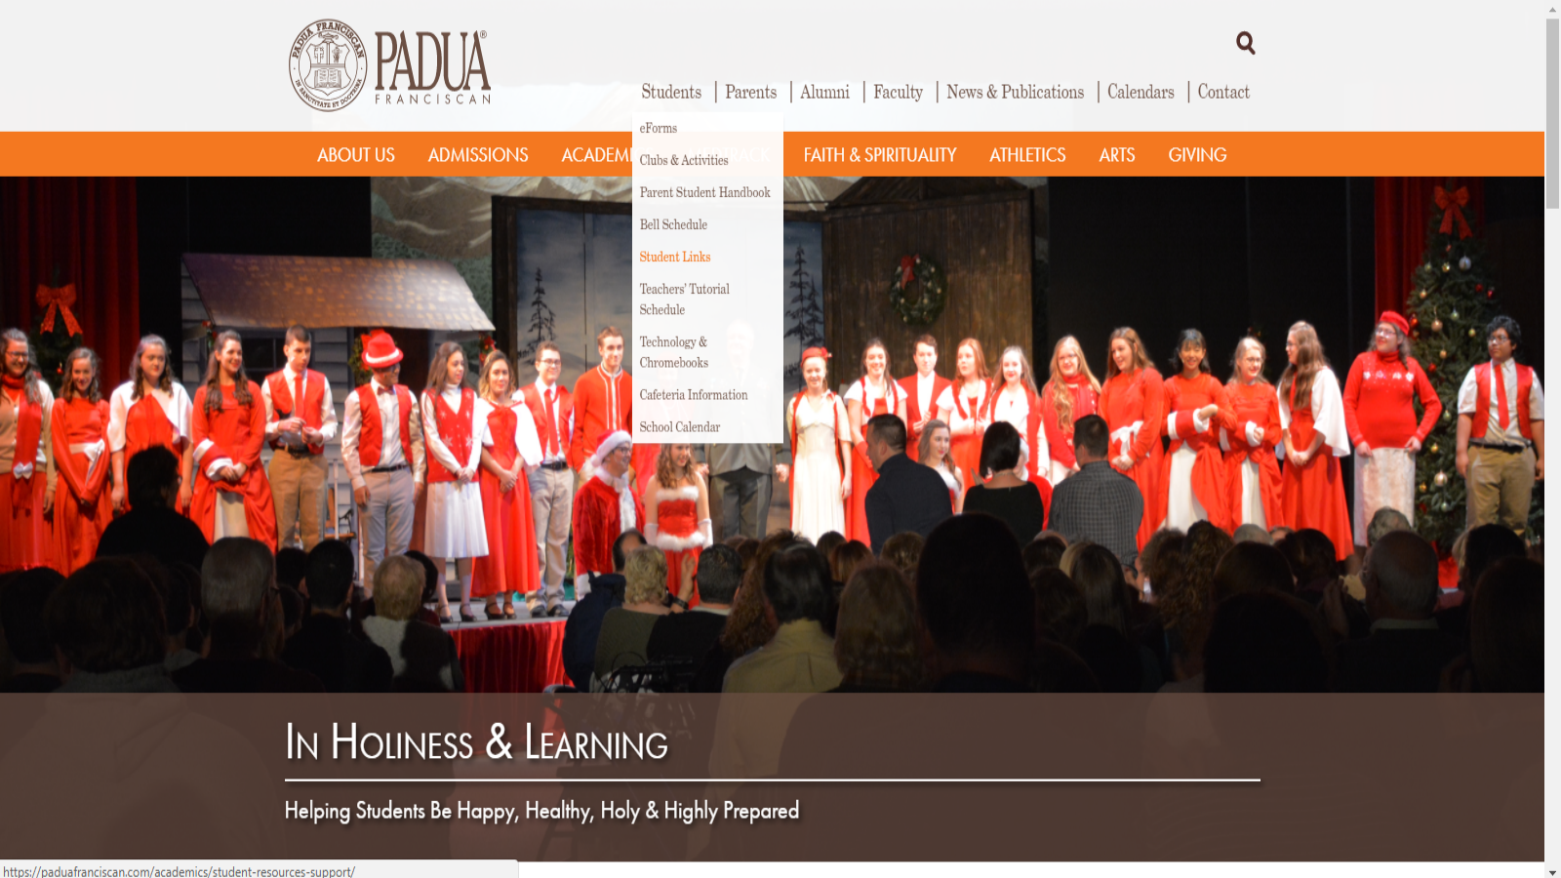
FAMILY CONNECTION

Slide 19
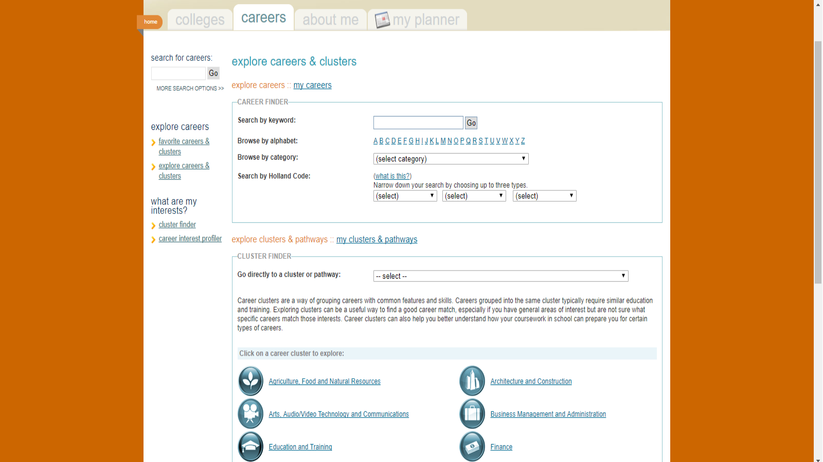

Slide 20
Financial Aid

Slide 21
Financial Aid
College Now Greater Cleveland –provides resources and support to students and families to prepare for opportunities after high school
Pam Sandoval – College Now Advisor

Slide 22
REMINDERS
Timeline handout located in tonight’s folder
Additional Handouts: Religious Vocations and Military Options
Course Registration
February 21st in Homeroom
Career & College Planning Events:
- February 28th : Career Speaker selection
- March 21st : Career Speaker Forum
- May: Presentation by Baldwin Wallace University on
college selection via college major focus

