Slide 1
FRESHMEN PARENT INFORMATION NIGHT
Padua Franciscan High School
Guidance Department

Slide 2
Outline of Evening
Pre-ACT Results and how to relate them to the College Planning Process and the choice of a College Major.
Some initial thoughts about College Planning.
  OSU Admissions – Keith Lofton
Family Connection/Naviance Succeed – our major tool to assist families in this Process.
Freshman Course Registration.

Slide 3

Factors in Student Success
Academic Development
  High School Course Selection
  College Readiness Testing
Career Planning
  Career/Vocational intentions
  Appropriate College Major
Preparation for College or the Workplace
  Extra-curricular Involvement
  Leadership opportunities
  Life Experience

Slide 4
College Testing at Padua Franciscan
Freshman Year Pre-ACT
Sophomore Year PSAT (for Practice only)
Junior Year PSAT/NMSQT
Practice ACT
(optional March)
                ACT and/or SAT
Senior Year Retake ACT/SAT (as appropriate)
SAT-II (if required)

Slide 5

Pre-ACT

Slide 6
Why Pre-ACT?
1) Where do I stand right now?
2) How can I make goals for the future?
3) Am I on target for college and a career?

Slide 7

Academic Tests Given to
Class of 2020
Mathematics
Science
English
Reading

Slide 8
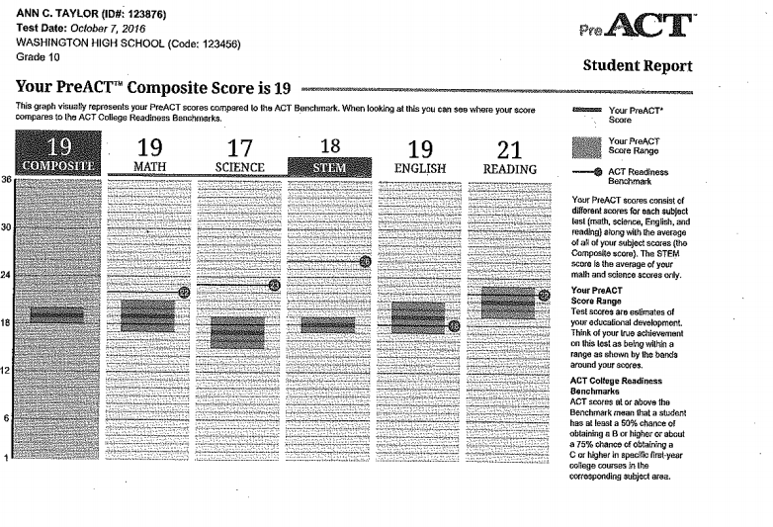
Average of E, M, R and S
Scores between 1 and 35
Score Ranges (predicted ACT)
Benchmarks-
At or above: 50% chance of earning an A or B in first year
college course and a 50% chance of earning a C or better

Slide 9
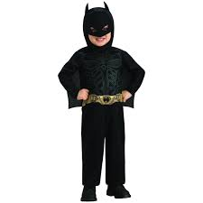

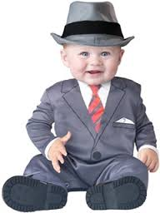
CAREER INTERESTS / RESEARCH

Slide 10
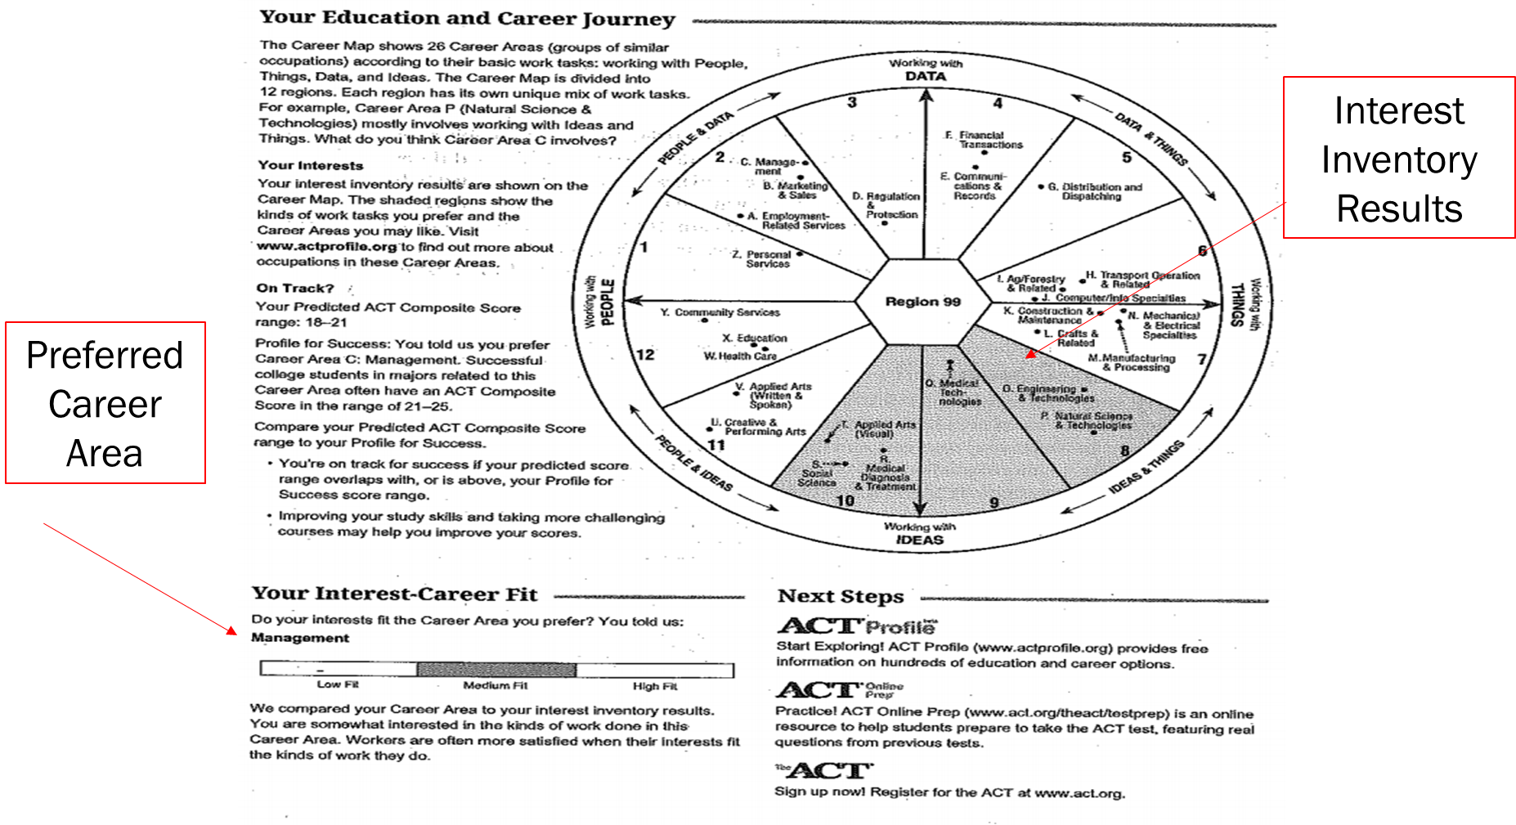

Slide 11
BUILDING YOUR SKILLS
Provides Correct Answers, Your Answers and Ideas for Progress (Improvement)

Slide 12
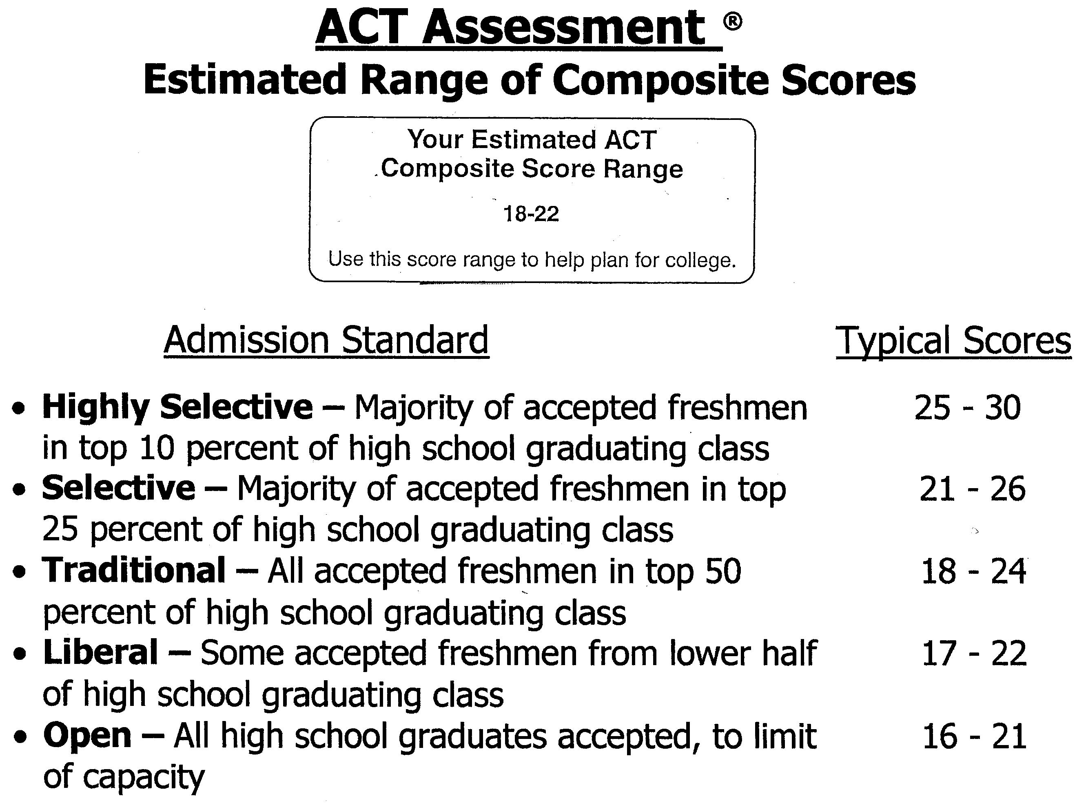

Slide 13

COLLEGE READINESS

Slide 14
ACT College Readiness Benchmark Scores
College Subject ACT Score
English Composition 18 on English Test
Algebra 22 on Math Test
Social Studies 22 on Reading Test
Biology 23 on Science Test

Slide 15
Where Class of 2016 went
Publics
Cuyahoga Comm. College
Ohio State Univ.
Bowling Green State Univ.
Cleveland State Univ.
Univ. of Toledo
Kent State Univ.
Ohio University
Privates
John Carroll Univ.
Xavier University
Baldwin-Wallace Univ.
Univ. of Dayton
Mercyhurst Univ.
Duquesne Univ.
Ashland University

Slide 16
What Can I Do As A Parent To Assist My Child In The College Selection Process?

Slide 17

Keith Lofton
Territory Manager for The Ohio State University

Slide 18
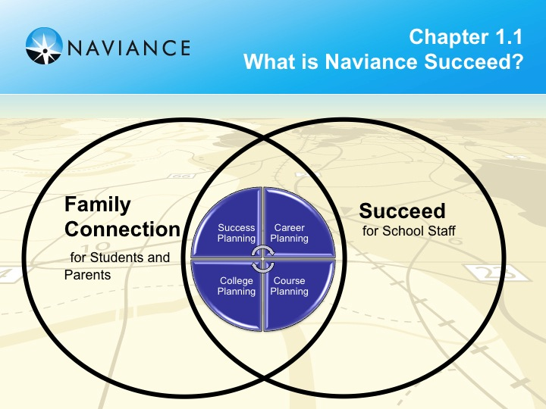
Notes:
Communication between counselors, students, parents (re- visits, scholarships, summer programs…)
All under one roof- a portal

Slide 19
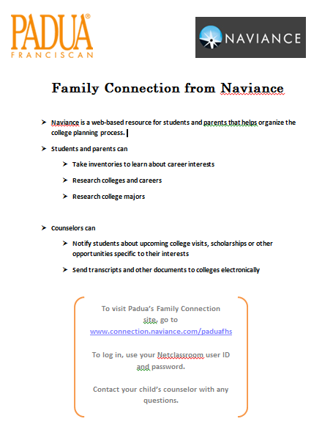

Slide 20
With Family Connection
You Can…
Help students learn about their personality type and interests
Find information on careers (pay, skills, job outlook…)
Find out what to major in to be a ________
Narrow down your college search by countless criteria (size, location, activities, major, religious affiliation…)
Find out what colleges offer a particular major
Find out your chances of being accepted to _____ University
See which colleges are visiting Padua each week
Explore scholarship opportunities

Slide 21

Understand their unique strengths
Connect their interests to careers
Set goals
Develop self-knowledge and personal motivation
Understand college possibilities
Explore high school specific college admissions stats
Match to best-fit colleges
Identify ideal college majors

Slide 22

FAMILY CONNECTION

Slide 23
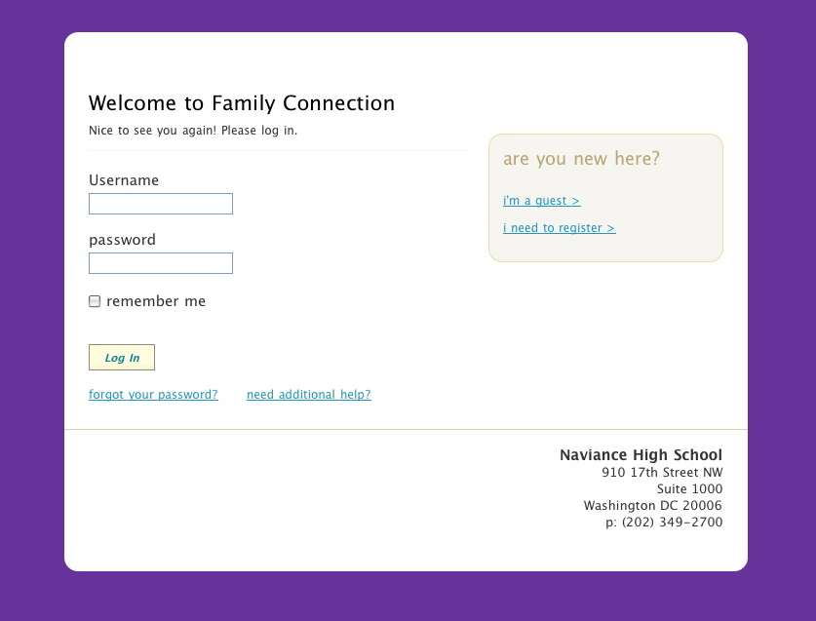
How d
Use student’s Username and Password
Notes:
Give instructions on registration

Slide 24

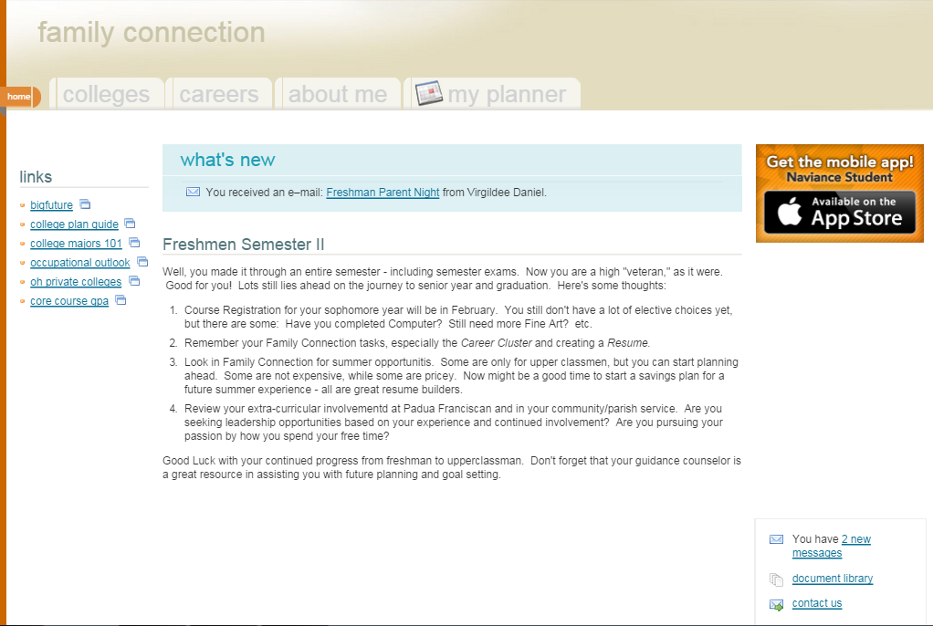



Slide 25
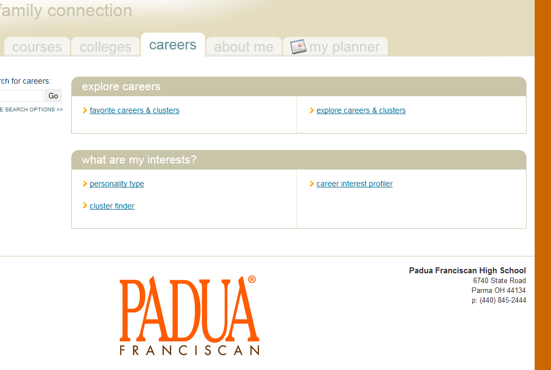
CLUSTER FINDER
Notes:
Talk about colleges tab too

Slide 26
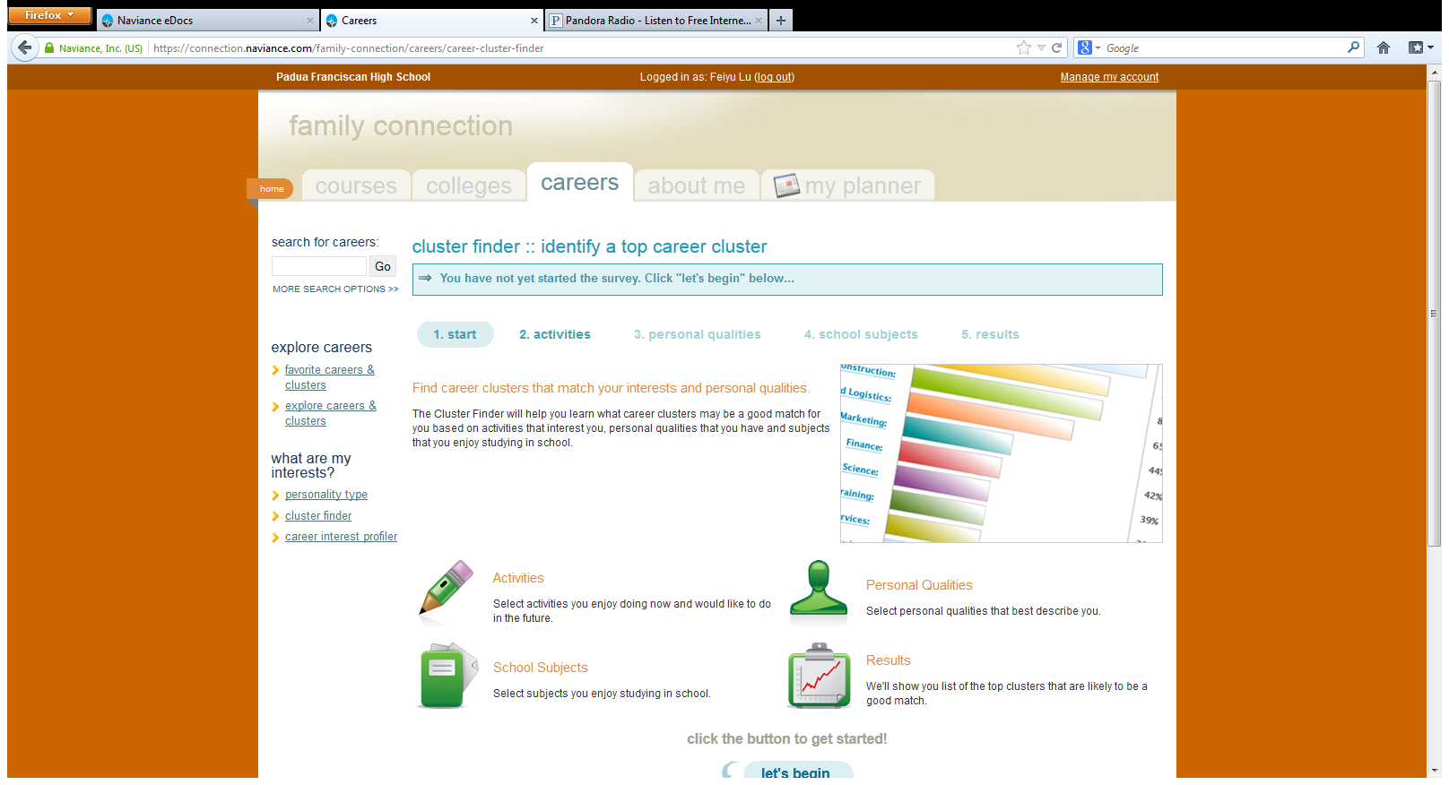

Slide 27
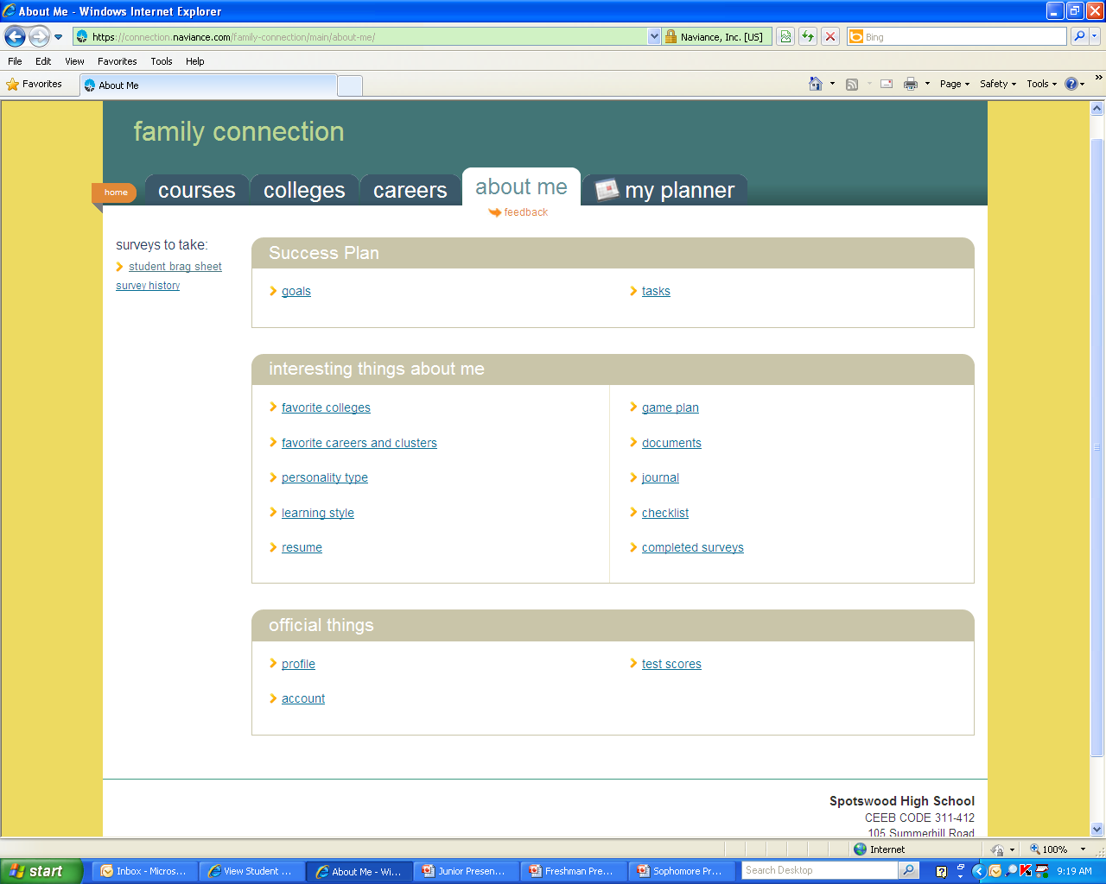
Click Here to begin your Resume. This can be accessed by your teachers and counselors to use when writing personalized letters of recommendation.

Slide 28
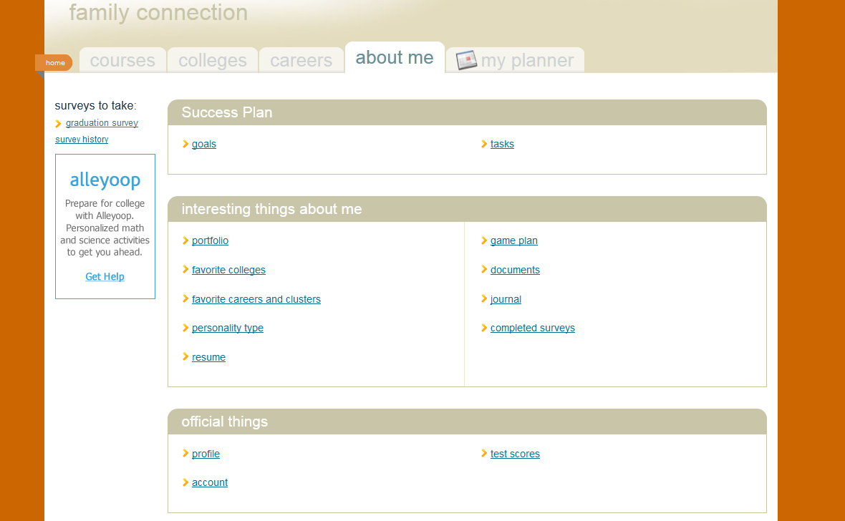
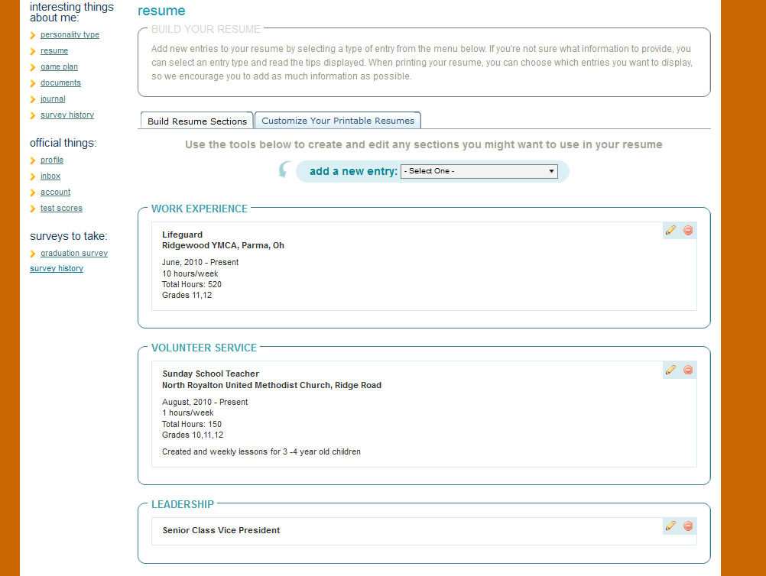

Slide 29
Suggested Family Connection Activities
By Grade Level
Freshmen:
Update profile in My Account
Complete Strengths Explorer and Learning Style Indicator
Complete Cluster Finder in Careers
Start Resume
Research Summer Enrichment Programs

Slide 30
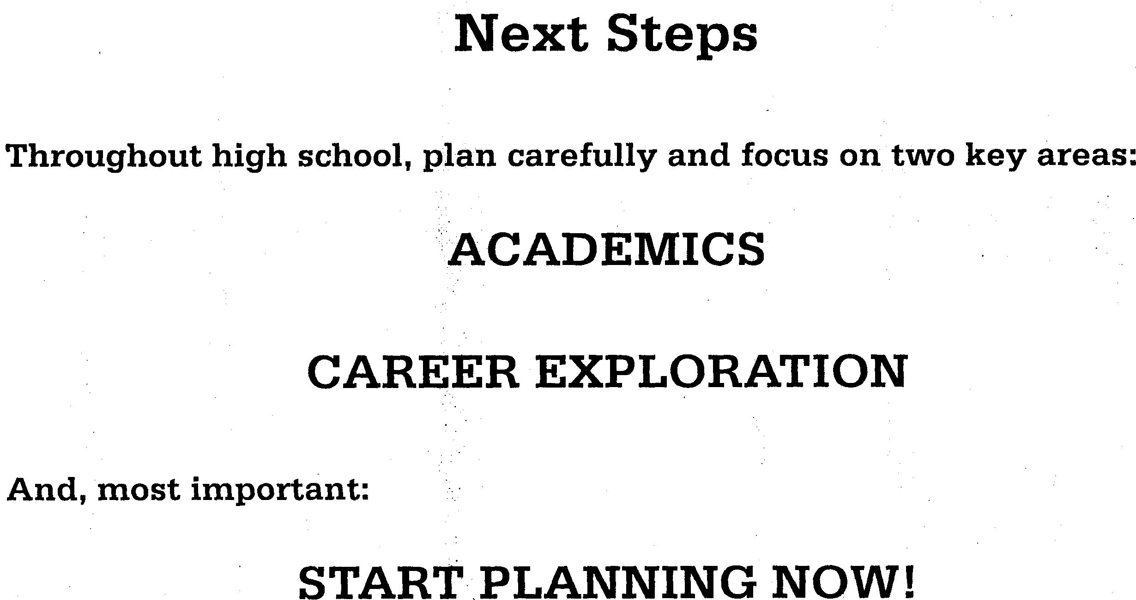

Slide 31

What are Colleges looking for?

Slide 32


What are Colleges looking for?
Numbers Game
Holistic Review

Slide 33
What are Colleges looking for?
Overall GPA and class rank/standing
Scores on the ACT and/or SAT-I
Strength of curriculum taken in high school
Resume of extra-curricular activities
  Using one’s talents
  Developing inter-personal and leadership skills
  Service to Others
  Enrichment

Slide 34

And, for the Athlete:

Slide 35
NCAA Eligibility
Div I & Div II
Padua’s Graduation Requirements meet or exceed the NCAA 16 Core Course Credit Rule
Following Padua’s year-by-year requirements will meet or exceed the Div I Eligibility Rule of 10 core credits completed prior to Senior Year
    7/10 Rule

Slide 36
COURSE REGISTRATION
February 21st – Presentation to all freshmen
February 23rd – Actual course registration
PADUA FRANCISCAN HIGH SCHOOL COURSE CATALOG MAY BE FOUND ON WEBSITE UNDER ACADEMICS TAB

Slide 37
To Get Into College…
Work hard to get good grades
Take challenging courses

Slide 38
PADUA FRANCISCAN HIGH SCHOOL
Thank you for coming to tonight’s presentation.
Questions:
  Please contact your Guidance Counselor –
  phone, appointment, email
Mrs. M.L. Sidoti, grade 9
Mr. Andrew Shuman, grades 9 & 10 MedTrack
Mr. Virgil Daniel, Department Chair

Slide 39


Slide 40


